Slide 1
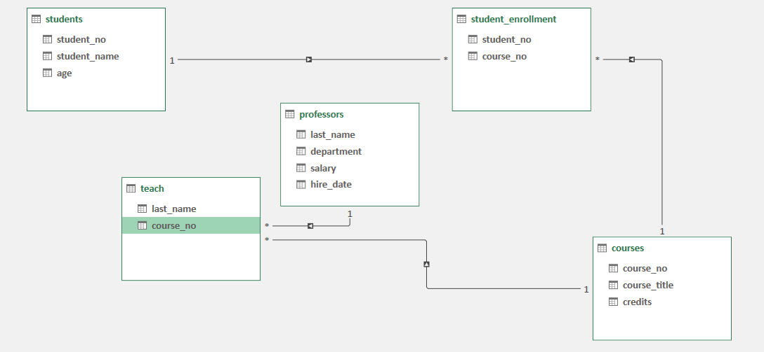
Entity Relationship Model of College Database

Slide 2
This is the College Database
Total five Tables
Students
Student enrollment
Courses
Professors
Teach

Slide 3
Simple Questions
Q 1; Write a query to display the names of those students that
are between ages of 18 and 20
Q 2; Write a query to display all of those students that contain the
letters "ch" in their name or their name ends with letters "nd".
Q 3; Write a query to display the name of those students that have the letters
"ae" or "ph" in their name and are NOT 19 years old
Q 4; Write a query that lists the names of students sorted by
their age from largest to smallest
Q 5; Write a query that displays the names and ages of the top 4
oldest students
Q6; Write a query that returns students base on the following criteria
The student must not be older than age 20
if their student no is either 3 and 5 or their student no is 7.
your query should also return students older than age 20 but in that
case they must have a student no that is at least 4.

Slide 4
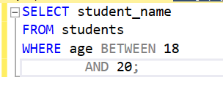
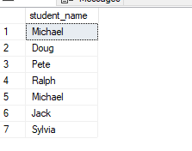
Q 1; Write a query to display the names of those students that are between ages of 18 and 20

Slide 5
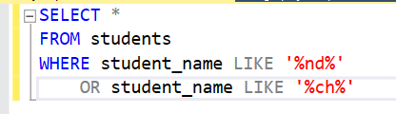
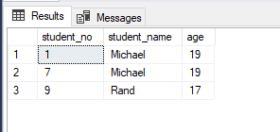
Q 2; Write a query to display all of those students that contain the letters "ch" in their name or their name ends with letters "nd".

Slide 6
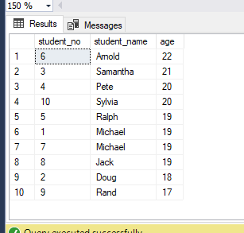

Q 4; Write a query that lists the names of students sorted by their age from largest to smallest

Slide 7
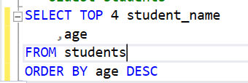
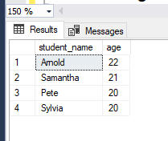
Q 5; Write a query that displays the names and ages of the top 4 oldest students

Slide 8
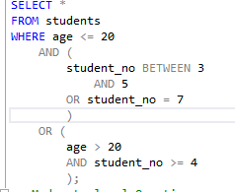
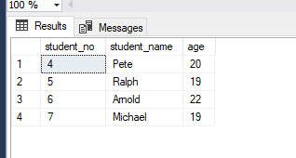
Q6; Write a query that returns students base on the following criteria The student must not be older than age 20 if their student no is either 3 and 5 or their student no is 7. your query should also return students older than age 20 but in that case they must have a student no that is at least 4.

Slide 9
- Moderate level Questions;
Write a query that finds students who do not take CS180.
2. Write a query to find students who take CS110 or CS107 but not both.
3. Write a query to find students who take CS220 and no other courses.
4. Write a query that finds those students who take at most 2 courses. Your query should exclude students that don't take any courses as well as those that take more than 2 course.
5. Write a query to find students who are older than at most two other students.

Slide 10
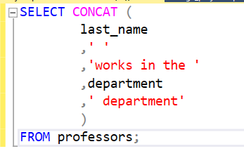
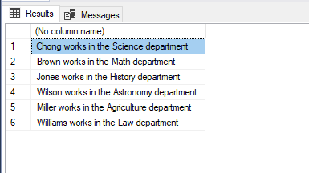
Q 1; Write a query against the professors table that can output the following in the result " chong works in the science department”

Slide 11
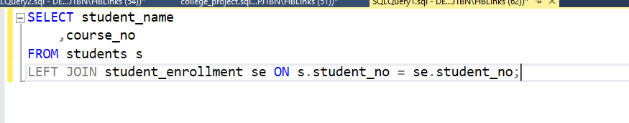
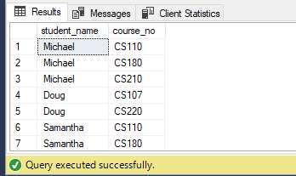
Q; Write a query that returns ALL of the students as well as any courses they may or may not be taking;

Slide 12
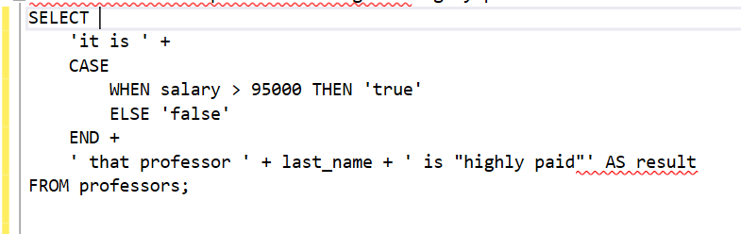
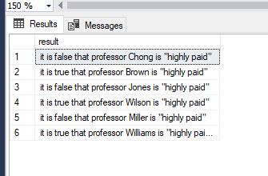
Q 2; Write a SQL query against the professors table that would return the following result
"it is false that professor chong is "highly paid"

Slide 13
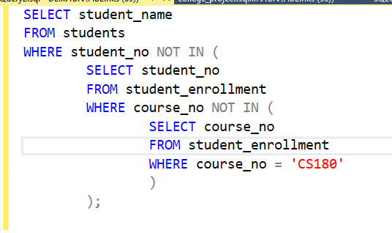
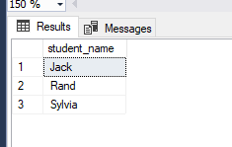
Q; Write a query that finds those students who do not take CS180 course

Slide 14
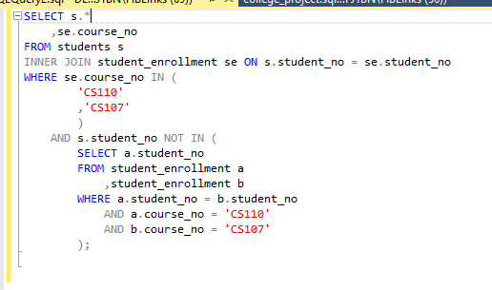
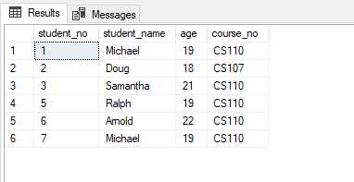
Q; Write a query to find the students who take CS110 or CS107 but not take both

Slide 15
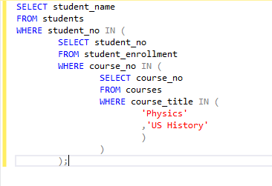
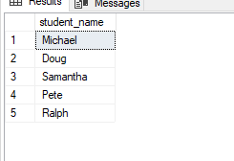
Q; Using subqueries only, write a SQL statement that returns the names of those students that are taking the courses PHYSICS and US HISTORY.

Slide 16
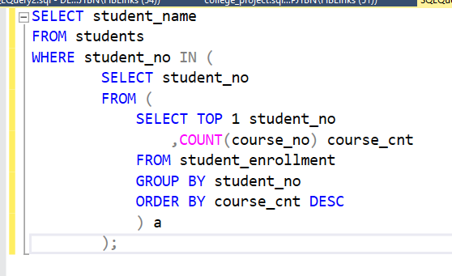
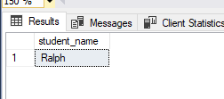
Q; The name of the student that takes the highest number of courses

Slide 17
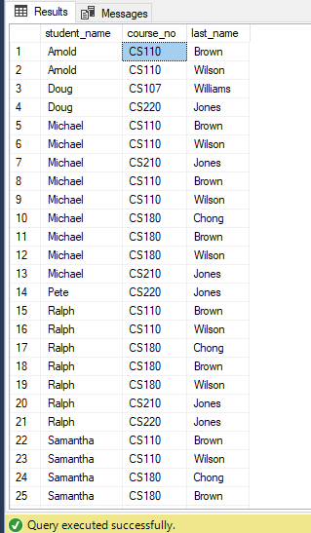
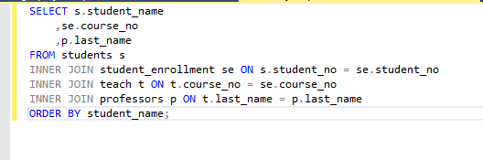
Q; Write a query that shows the student's name the courses the student is taking and the professors that teach that course.

Slide 18
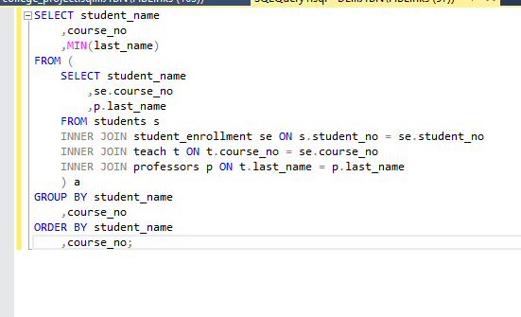
Second method

Slide 19
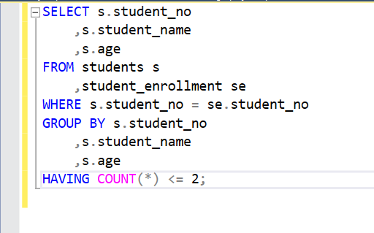
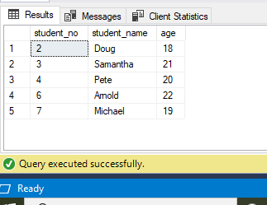
Q; Write a query that finds those students who take at most 2 courses. Your query should exclude students that don't take any courses as well as those that take more than 2 courses.

Slide 20
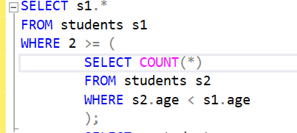
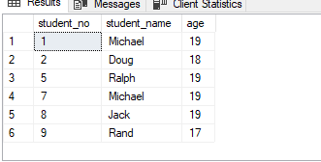
Write a query to find students who are older than at most two other students.

Slide 21
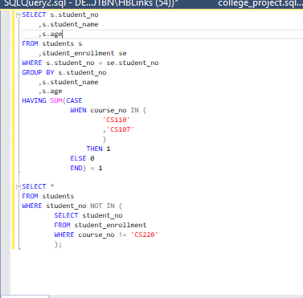
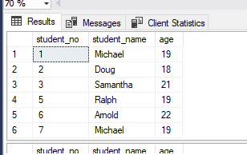
Write a query to find students who take CS110 or CS107 but not both.

